Slide 1

Machine learning Model Comparison on Diabetes Dataset
Swayanshu shanti Pragnya
Department of Computer Science & Engineering
UC, Denver

Slide 2
Contents:
This is an extensive Model analysis of the Data which includes the following analysis:
1. Data exploration (Data distribution inferences, Univariate Data analysis, Two sample t test) Answers few questions like Impact of Glucose on Diabetes, Hypothesis validation, Feature outcomes w.r.t outcome
2. Data Correlation Analysis
3. Feature Selection (using Logistic regression)
4. Outlier Detection (using principal component graph)
5. Basic Parameter Tuning(CP)
6. Data modelling
1. Basic GLM (model chosen based on AIC score)
2. Logistic Regression
3. Decision Tree
4. Naïve Bayes
5. Neural Network

Slide 3
Data:
The dataset used for the purpose of this study is the Pima Indians Diabetes Database from the National Institute of Diabetes and Digestive and Kidney Diseases. This diabetes database, donated by Vincent Sigillito, is a collection of medical diagnostic reports of 769 examples from a population living near Phoenix, Arizona,USA.
The samples consist of examples with 8 attribute values and one of the two possible outcomes, namely whether the patient tested positive for diabetes (indicated by output one) or negative (indicated by zero).
Several constraints were placed on the selection of these instances from a larger database. In particular, all patients here are females at least 21 years.
Pregnancies: Number of times pregnant
• Glucose: Plasma glucose concentration
• BloodPressure: Diastolic blood pressure (mm Hg)
• SkinThickness: Triceps skin fold thickness (mm)
• Insulin: 2-Hour serum insulin (mu U/ml)
• BMI: Body mass index (weight in kg/(height in m)ˆ2)
• DiabetesPedigreeFunction: Diabetes pedigree function
• Age: Age (years)
• Outcome: Class variable (0 or 1)
Diabetes mellitus is one of the major noncommunicable diseases which have great impact on human life today. Many nations are now facing a swiftly rising growth of diabetes among their residents.
According to a study by the World Health Organization (WHO), this number will have raised to 552 million by 2030, denote that one in 10 grownups will have diabetes by 2030 if no serious act is taken. In this, more than 80 % of diabetes deaths occur in low and middle income countries. Total deaths from diabetes are projected to rise by more than 50 % in the next 10 years.

Slide 4
Feature Explanation
Plasma Glucose Concentration a 2 hour in an oral glucose tolerance test (mg/dl)
Blood Pressure: Diastolic Blood Pressure(mmHg)
If Diastolic B.P > 90 means High B.P (High Probability of Diabetes)
Diastolic B.P < 60 means low B.P (Less Probability of Diabetes)
SkinThickness: Triceps Skin Fold Thickness (mm) – A value used to estimate body fat. Normal Triceps Skinfold Thickness in women is 23mm. Higher thickness leads to obesity and chances of diabetes increases.
Insulin: 2-Hour Serum Insulin (mu U/ml)
Normal Insulin Level: 16-166 mIU/L
BMI: Body Mass Index (weight in kg/ height in m2 )
BMI of 18.5 to 25 is within the normal range BMI between 25 and 30 then it falls within the overweight range.
A BMI of 30 or over falls within the obese range.
Diabetes Pedigree Function: It provides information about diabetes history in relatives and genetic relationship of those relatives with patients. Higher Pedigree Function means patient is more likely to have diabetes

Slide 5
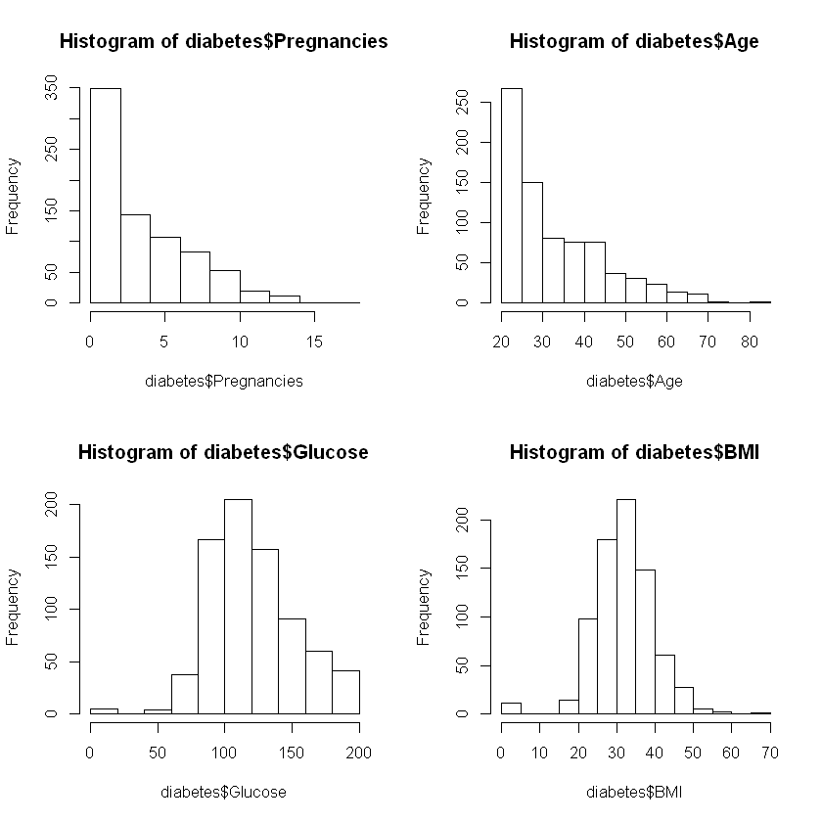
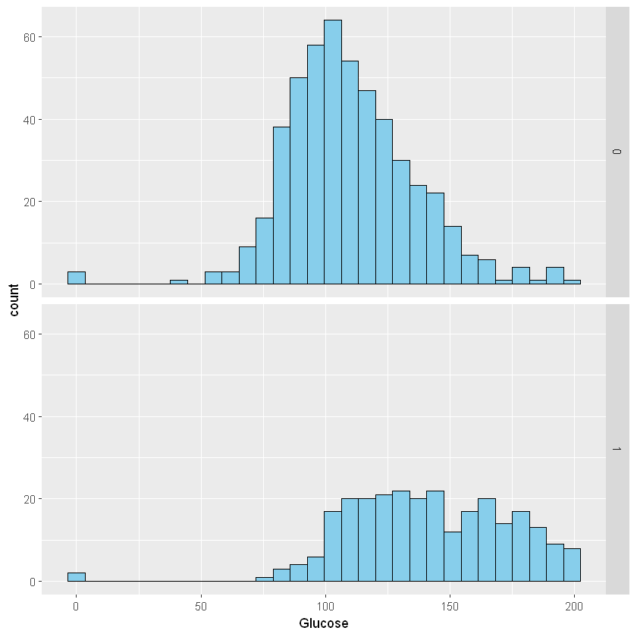
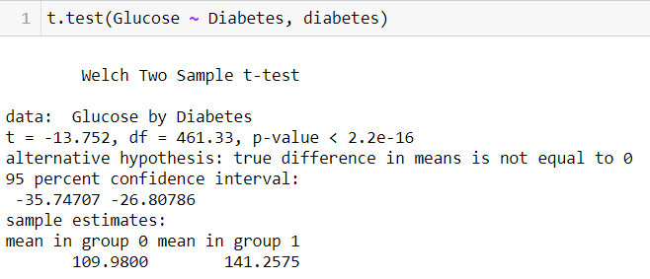
From these distribution graphs, Age and number of times pregnant are not in normal distributions as expected since the underlying population should not be normally distributed either. Glucose level and BMI are following a normal distribution.
Impact of Glucose on Diabetes
Conditions
Individuals are independent of each other
Here distributions are skewed but the sample >30
Both the groups are independent of each other and sample size is lesser than 10% of the population
p-value is < critical values of 0.05, so we reject the null hypothesis for the alternate hypothesis. i can say that we are, 95 % confident, that the average glucose levels for individuals with diabetes is > the people without diabetes.

Slide 6
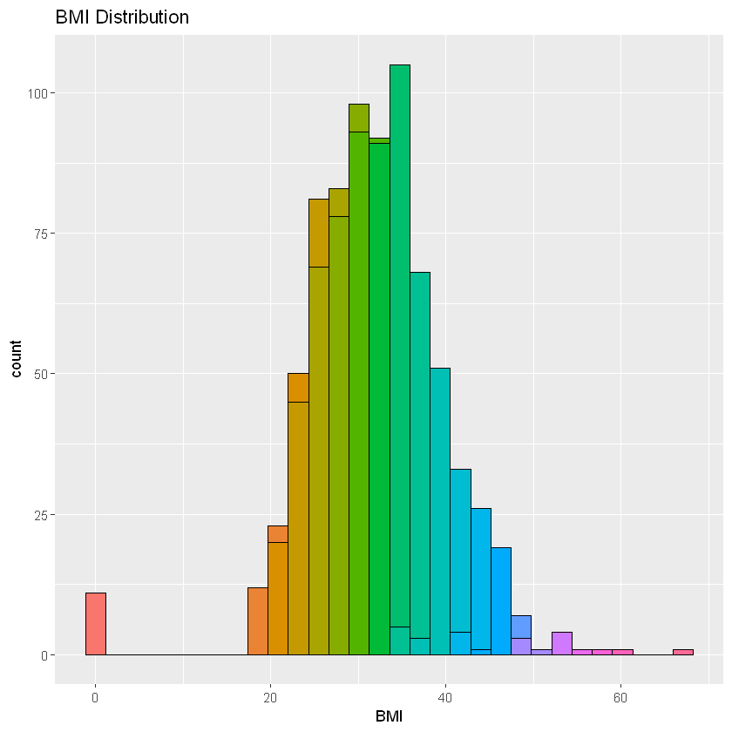
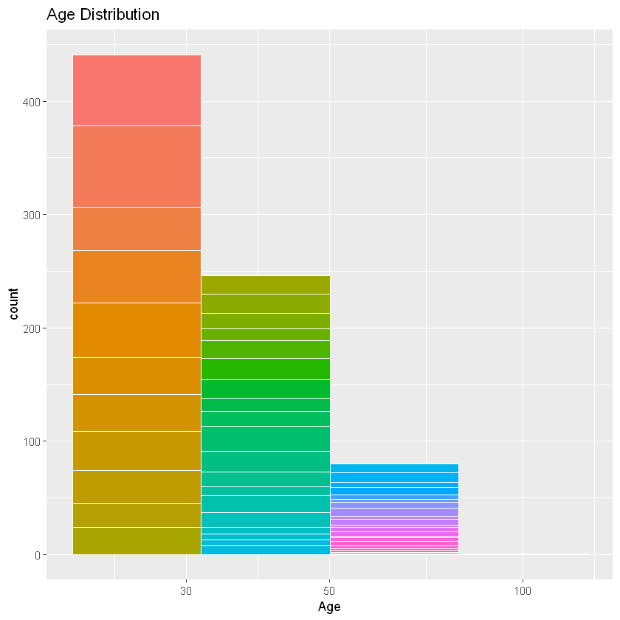
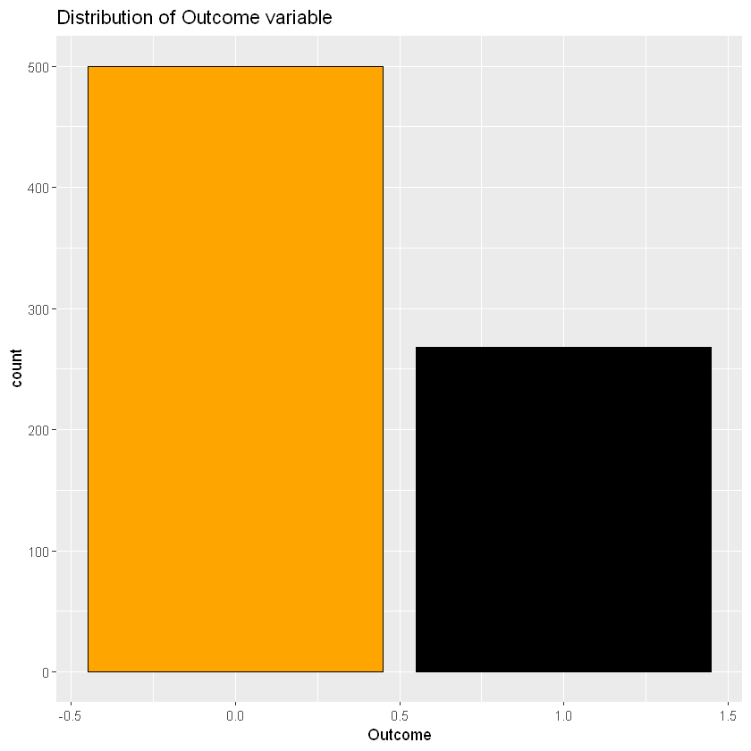
The dataset contains a fair distribution of age groups, most being under 30 with a second large group between 30 and 50 years of age Plotting the ages of the diabetic group we see a clear indicator showing more frequency at lower age groups Correlation does not equal causation, however diabetes is often associated with lifestyle habits, even in the West, and if younger Pima people are adopting a Western lifestyle and eating habits this could explain the effect on the younger population versus folks aged over 45
I need to predict the diabetic indicator We can see the data is a near 50/50 split between diabetic and non-diabetic

Slide 7
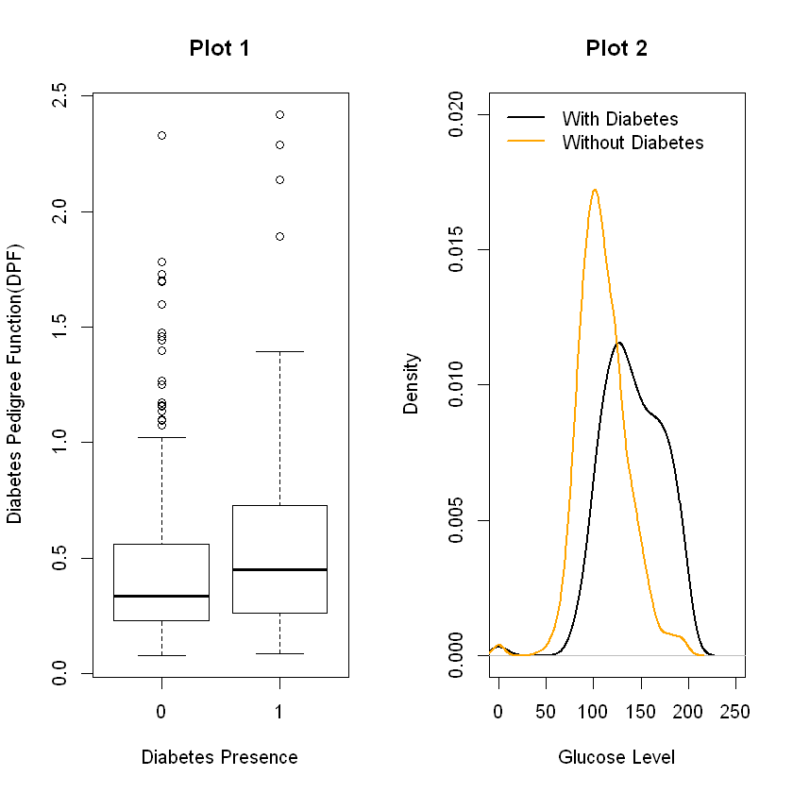
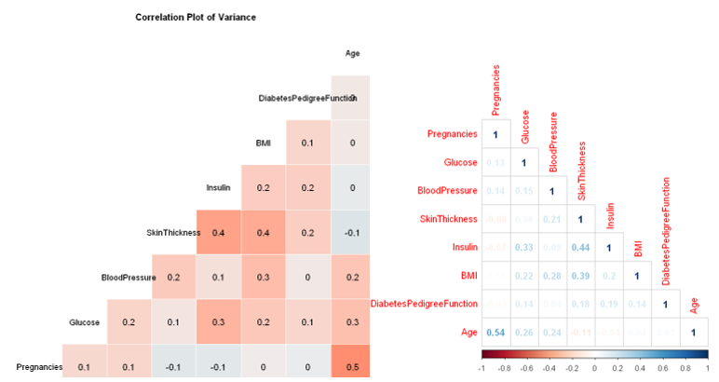
Pregnancies & Age : 0.5 => About 50% correlated to each other SkinThickness - &Insulin, &BMI : 0.4 => About 40% correlated to each other moreover, Pregnancy, Age, Insulin, skinthickness are having higher correlation.
From Plot 2 the distribution is shifted towards the left for those without diabetes. This indicates those without diabetes generally have a lower blood glucose level.

Slide 8
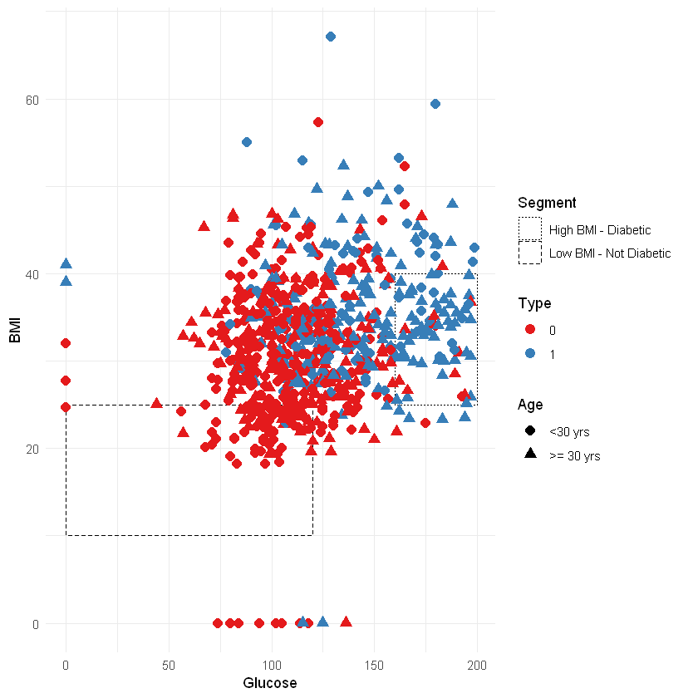
Graphical Clustering
It is simply using a scatterplot and a few plotting parameters in ggplot2 to make some things visible at the viewer. The boxes that we can draw clearly indicates 2 clusters
showcase the “clusters” a little better, along-with the multi-layered information, e.g., age, BMI, glucose, etc.
Notice the cluster on the right, showing a clear grouping of how high BMI correlates with being diabetic when combined with glucose levels.

Slide 9

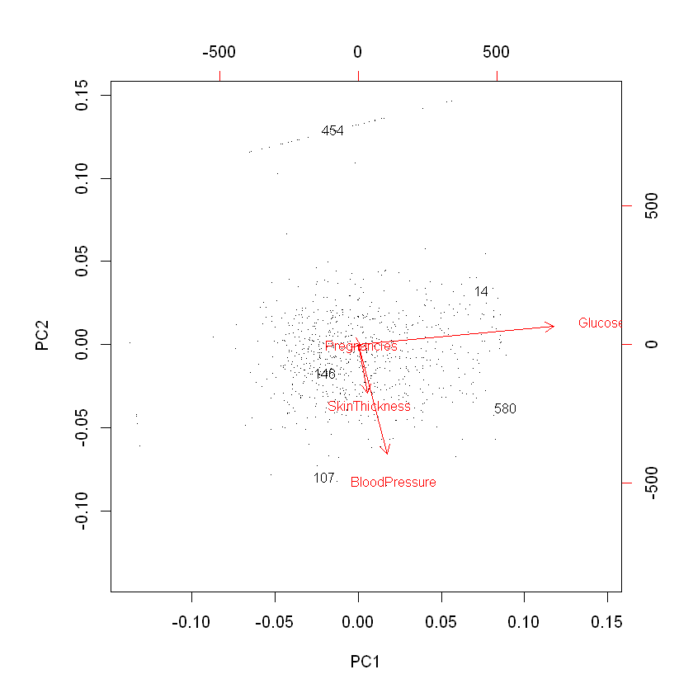

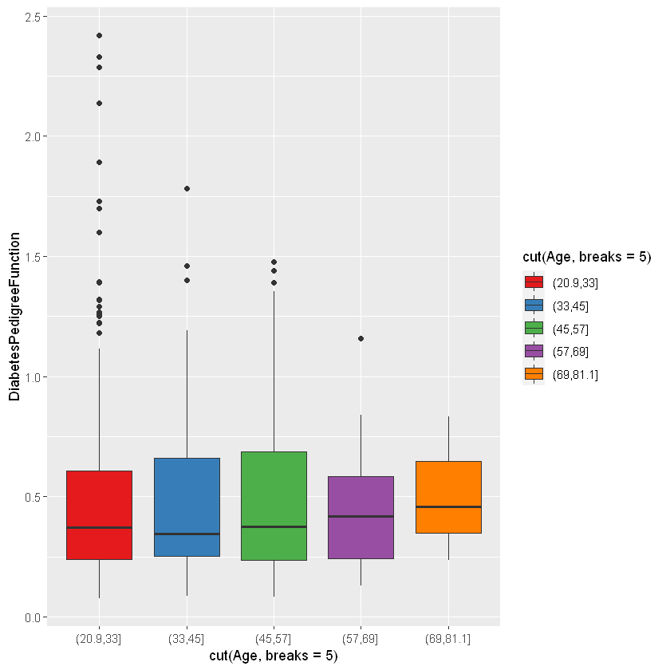
Outlier Detection
The five outliers obtained in the output are the row numbers in the diabetes1 data derived from the diabetes data set.

Slide 10
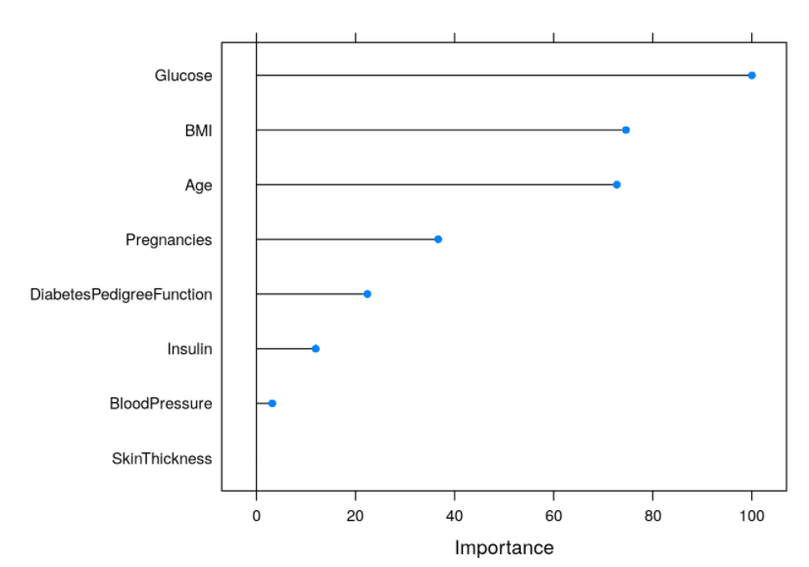
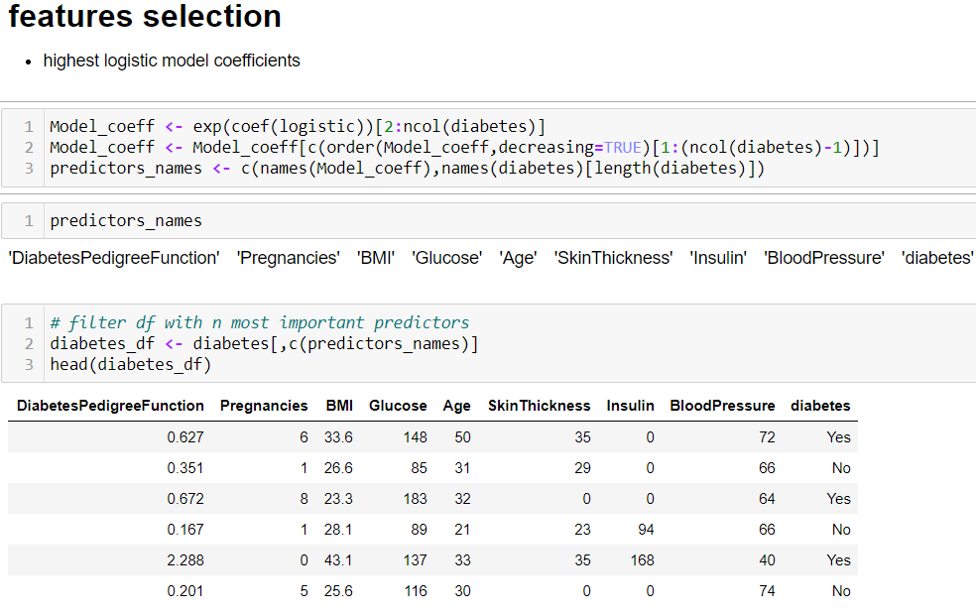
Logistic regression for
Mean Decrease : Glucose > BMI> Age

Slide 11

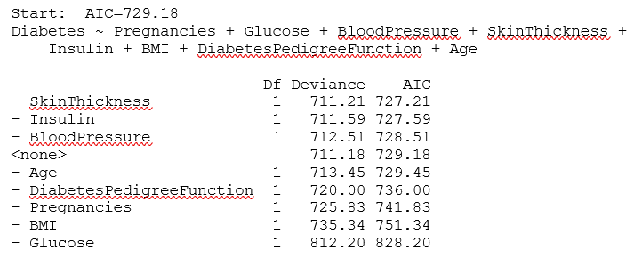
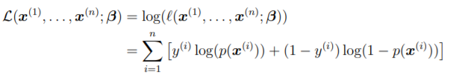
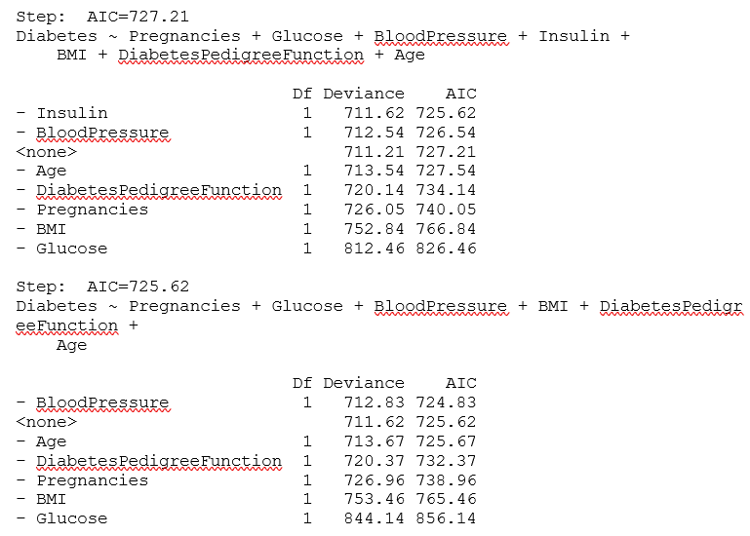
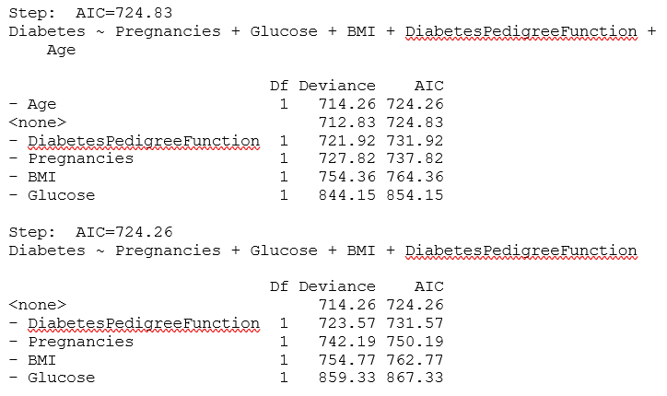
Model Selection Based on AIC
Maximizing the likelihood = maximizing the log-likelihood(model)
The above equation is non-linear for logistic regression and its minimization is generally done numerically by iteratively re-weighted least-squares
Final model is chosen with AIC as the selection generated from a logistic regression model with the lowest AIC value of 724.26

Slide 12
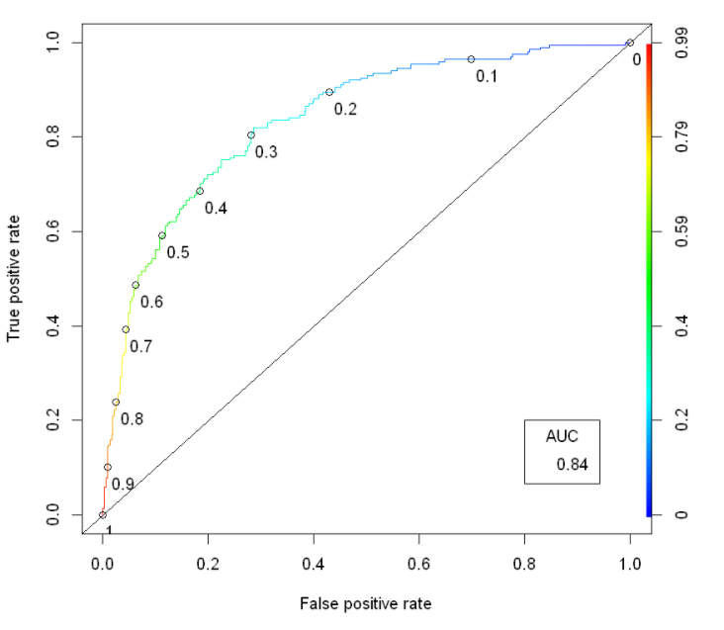
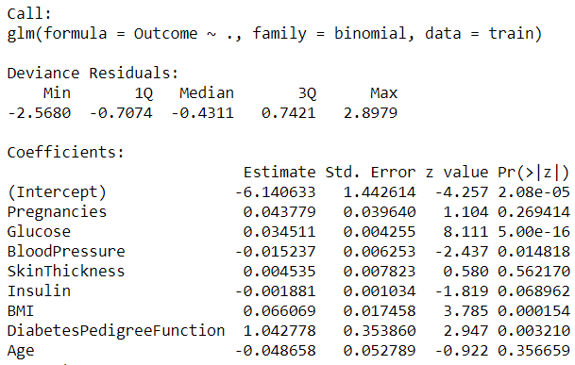
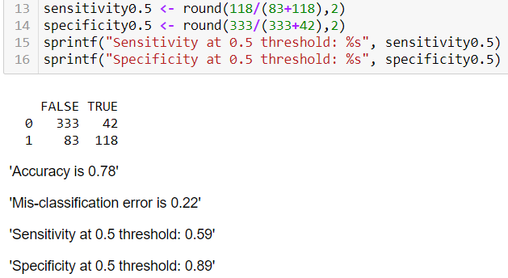

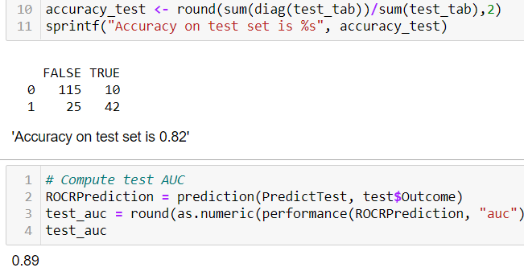
Model using all independent variables: Our baseline model accuracy is 65%
By using all variables, i got 78% accuracy in training with 0.5 threshold and in test i got 89% which is great.

Slide 13
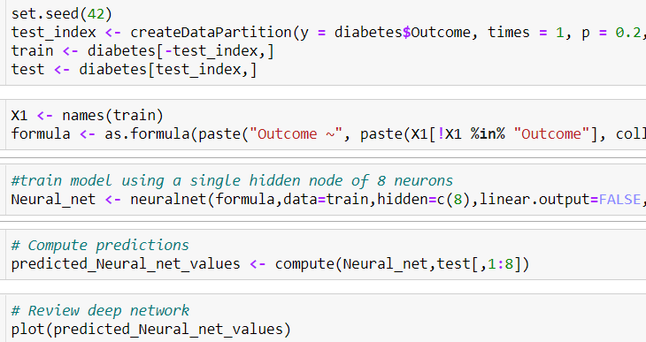
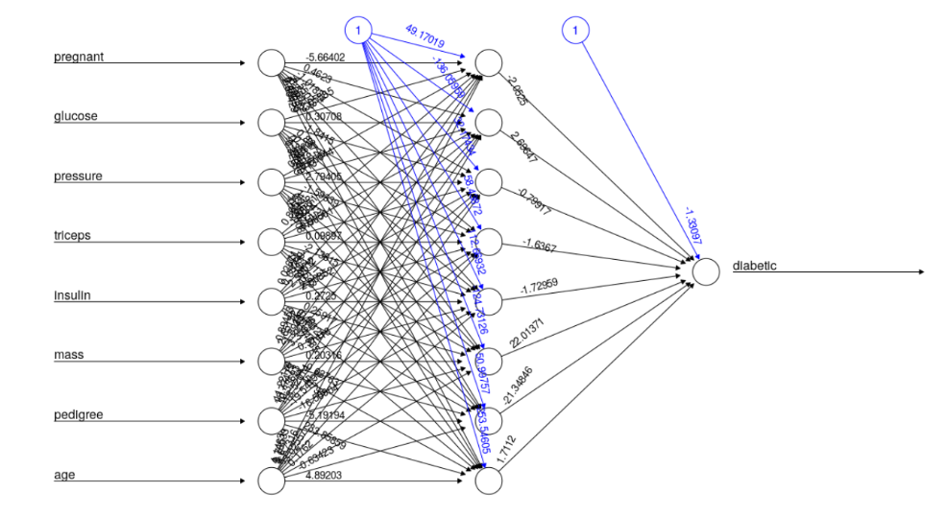
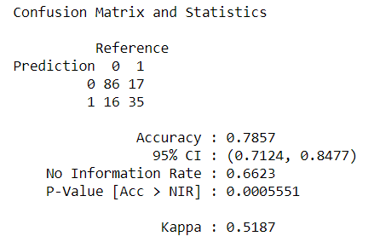
Neural Network
Here the weights have been recursively calculated using the back propagation algorithm, and a bias term has been introduced for the node in the hidden layer. This bias term enables the results to be generalized, instead of being limited to that instance of the data.
The individual weights represent the strength of connections between the units. The activation function used here is the “logistic” activation function, in order to take into consideration any nonlinear properties in the network. Since the output is in the form of zero and one, that is, binary, therefore use of logistic regression is more appropriate.
The reason for the use of back propagation algorithm is that it helps to calculate a gradient, which gives the direction of the greatest rate of increase of the function. It’s easier and more accurate to recursively calculate the weights, as compared to feedforward network where the data only moves in one direction, that is, forward.
Split into 90/10 training/test split
I’ll split our dataset into a 90/10 training/validation split. Our neural network consists of 3 layers (input, hidden, output). Our hidden layer will contain 8 neurons. The input layer receives the 8 input variables, the output layer returns the outcome as a single value.
I chose 8 neurons for our hidden layer as our dataset is relatively small and simple, and this configuration has shown good results in previous studies. The final model architecture is shown below:

Slide 14
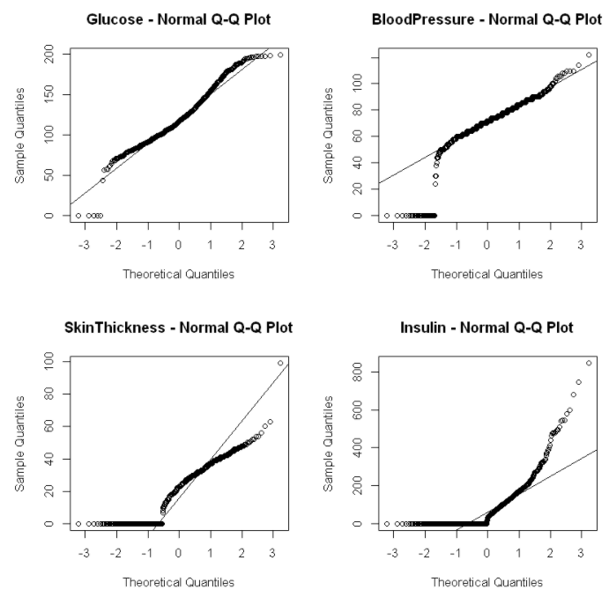
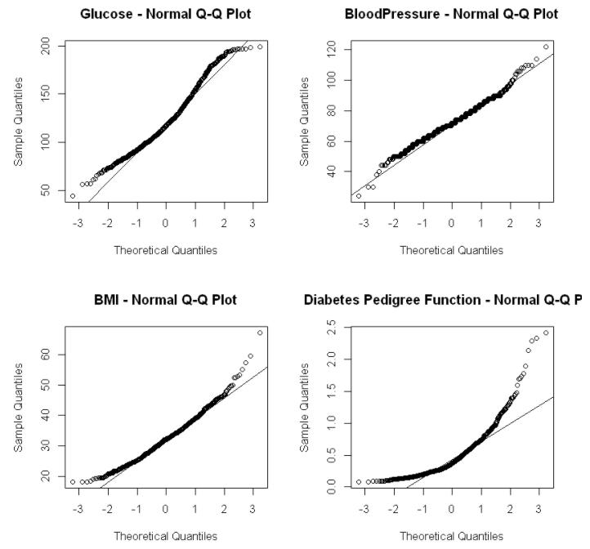
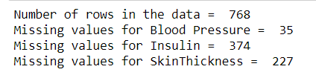
Challenges
With 0's
0's removed
1. Missing Data
# Half of the data for insulin = 0's, that is a big problem because
# the dataset only contains 768 observations. Skin thickness has 227
# values of 0, which must be missing data as well
# I have replaced 0’s with mean
2. Identifying the right packages for the models.
3. Correlated Data

Slide 15
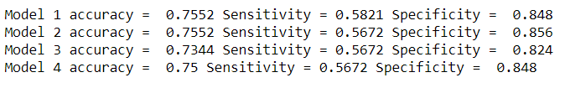
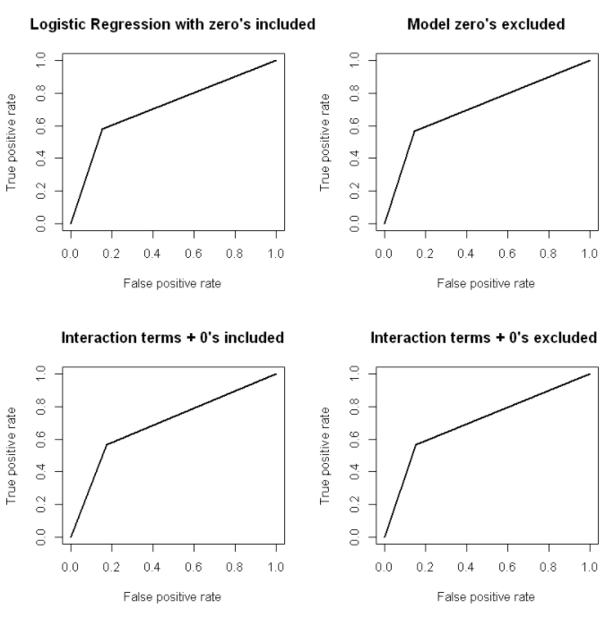
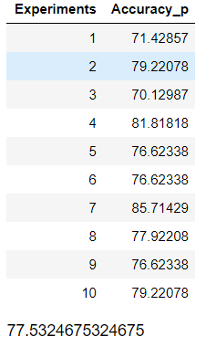
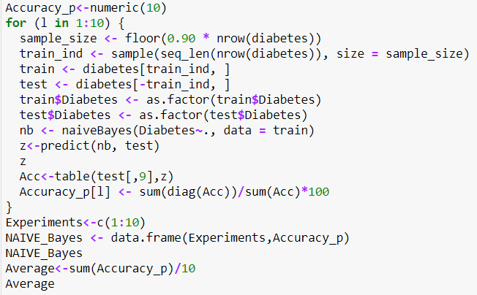
Logistic Regression with Missing value analysis
glm(formula = ., family = binomial(link = "logit"))
glm(formula = ., family = binomial(link = "logit"))
glm(formula = Outcome ~ BMI + Age * Glucose + BloodPressure, family = binomial(link = "logit"), data = training_set1)
glm(formula = Outcome ~ BMI + Age * Glucose, family = binomial(link = "logit"), data = training_set2)
It shows the tradeoff between True Positive Rate (TPR) and False Positive Rate (FPR) (any increase in (TPR) will be accompanied by a decrease in (FPR)).
The closer the curve towards TPR of the ROC space, the more accurate the test.
The closer the curve towards the FPR of the ROC space, the less accurate the test.
Naïve Bayes

Slide 16
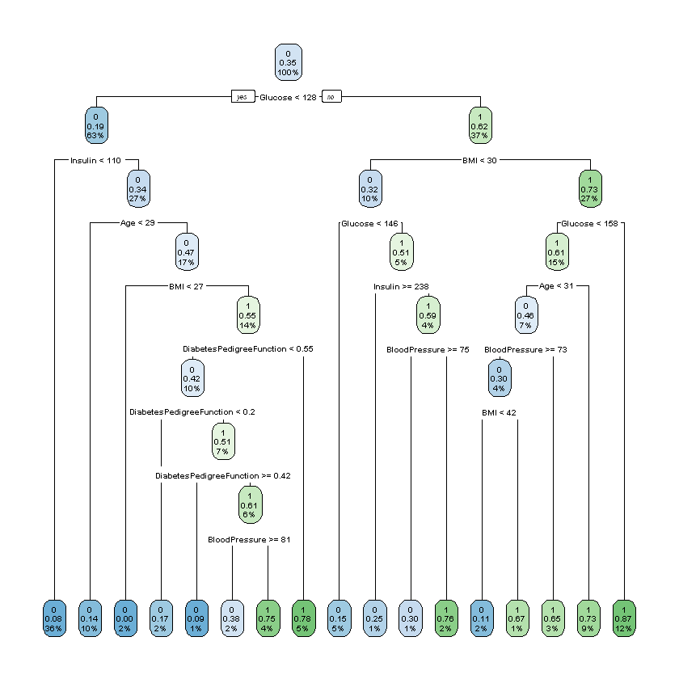
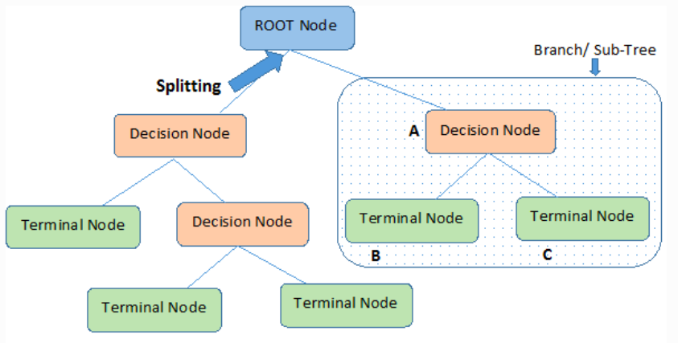
Decision Tree:
Root Node: It represents the entire population or sample, and this further gets divided into two or more homogeneous sets.
Splitting: It is a process of dividing a node into two or more sub-nodes.
Decision Node: When a sub-node splits into further sub-nodes, then it is called the decision node.
Terminal Node: Nodes do not split is called Leaf or Terminal node.
Pruning: When we remove sub-nodes of a decision node, this process is called pruning. You can say the opposite process of splitting.
Branch: A subsection of the entire tree is called branch or sub-tree.
Parent and Child Node: A node, which is divided into sub-nodes is called a parent node of sub-nodes whereas sub-nodes are the child of a parent node.
Interpretation: Starting from the root node, we go to the next nodes and the edges tell us which subsets we are looking at. When we reach the leaf node, the node tells us the predicted outcome. All the edges are connected by 'AND’.
In our example: If Glucose < 128, No then 1 (Diabetic), if BMI < 30, No then again diabetic

Slide 17
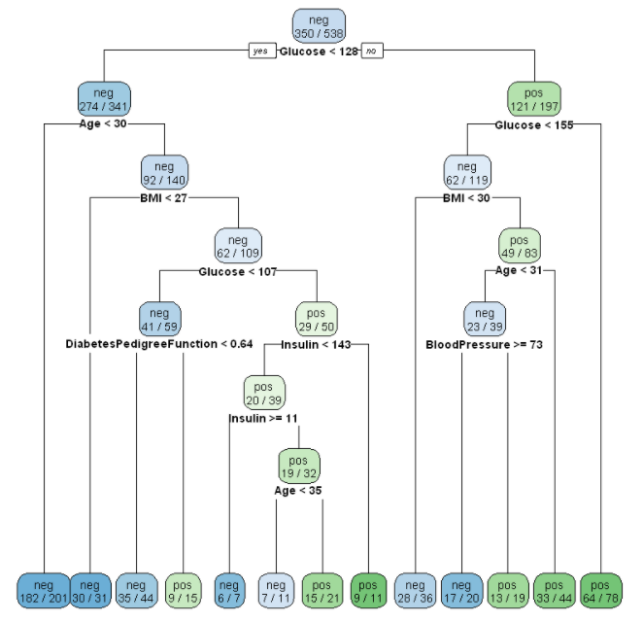
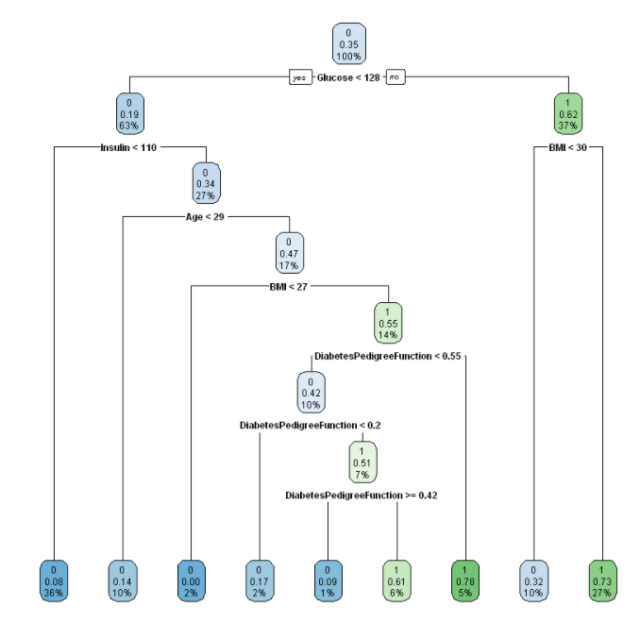
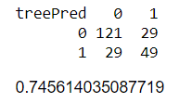
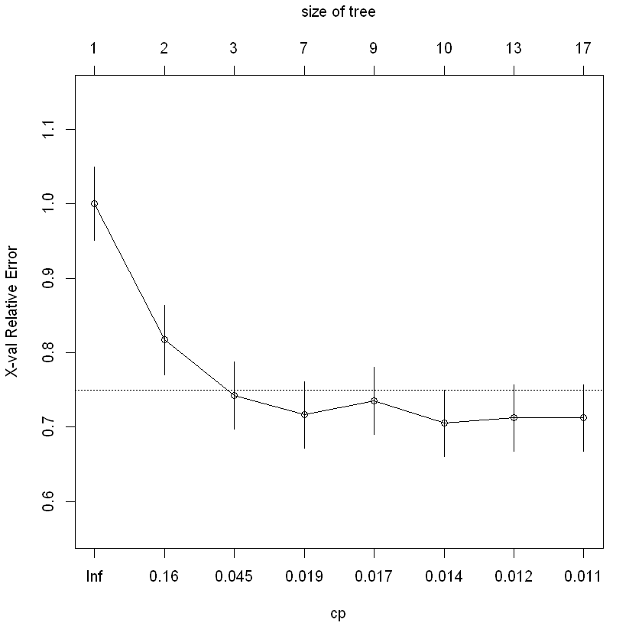
Decision Tree
The root node split in this tree started with Glucose attribute. No of samples It is the count of those samples whose glucose value is less than 154.5 Value – It gives the total no of samples for outcome ‘0’ and ‘1’.
The above tree was tuned using a reference of the Relative error VS Complexity parameter. From above figure the Cp value of 0.016, the decision tree was pruned. The final decision tree
Using prune( ) function by supplying optimal CP value. If we plot the optimal pruned tree we can now observe that the tree is very simple and easy to interpret. If a person has a glucose level above 128 and age greater than 25 will be designated as diabetes positive else negative.

Slide 18
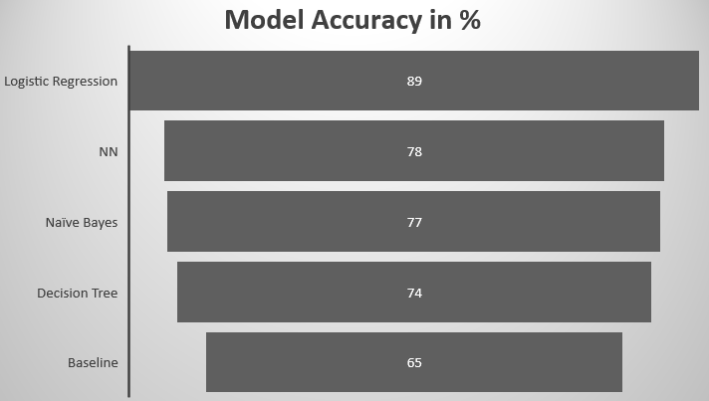
Model Comparison

